Slide 1

Homework 4 ChatGPT INT4023
Dalton Murray

Slide 2
Current state

Slide 3
What ChatGPT can really do
General purpose
Entertainment
Help with writing and rewriting drafts and other documents
Find out/learn new information
Help refine existing knowledge
Give straight to the point answers
Information/Cyber Security
Help give basic guidelines and tips to stay safe and secure online
Can help troubleshoot programming
Find existing problems and help patch them
*see limitations

Slide 4
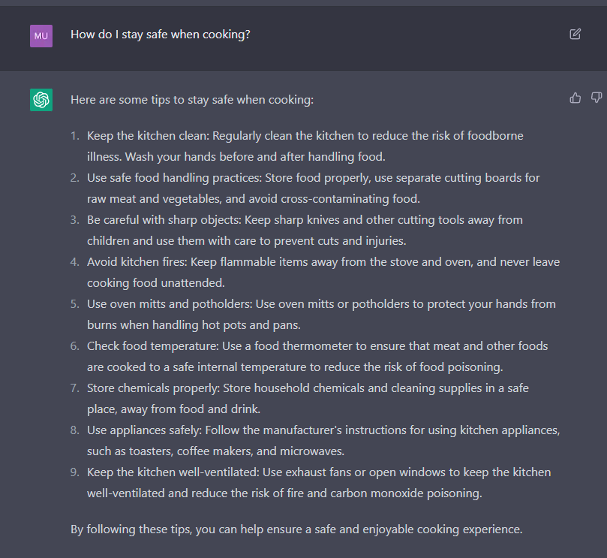
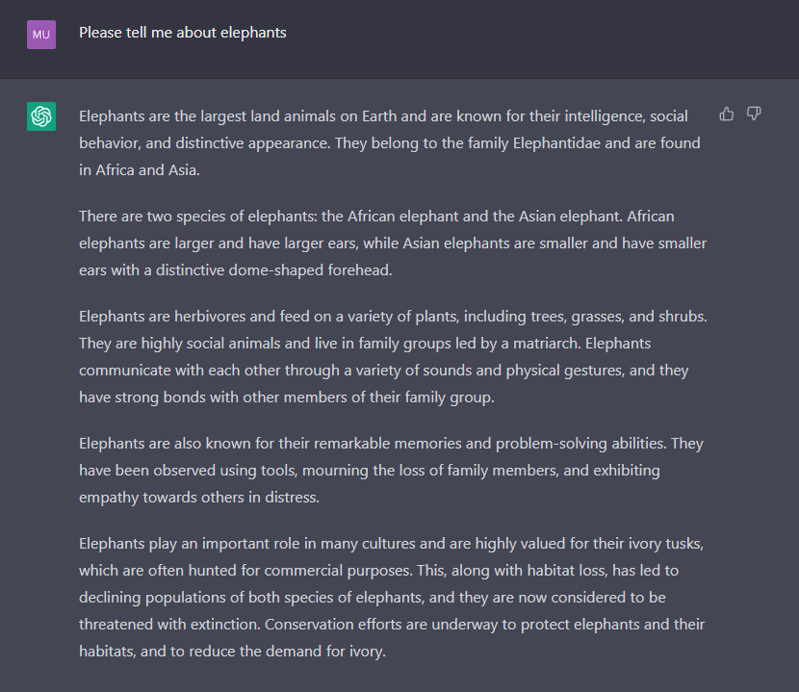
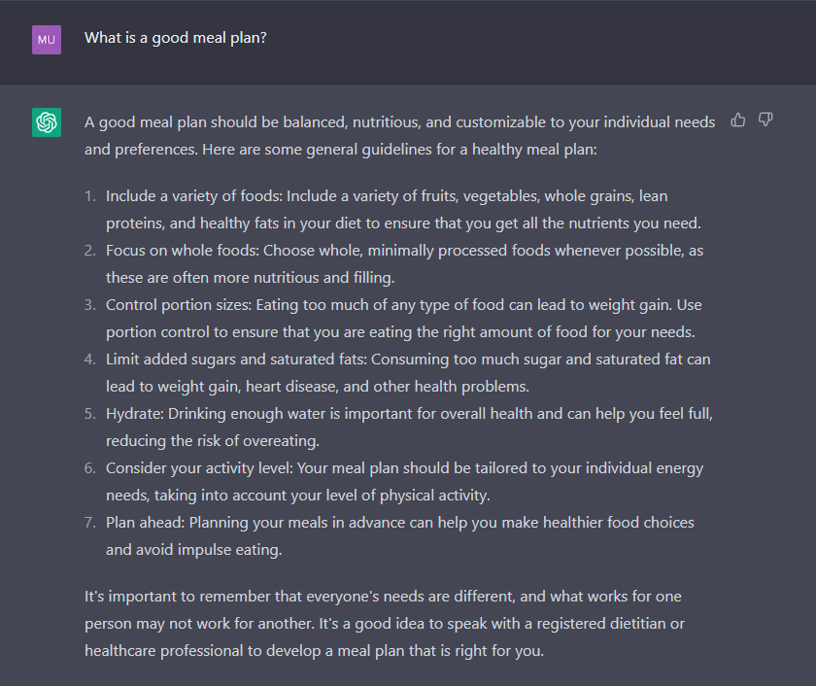
General Knowledge

Slide 5
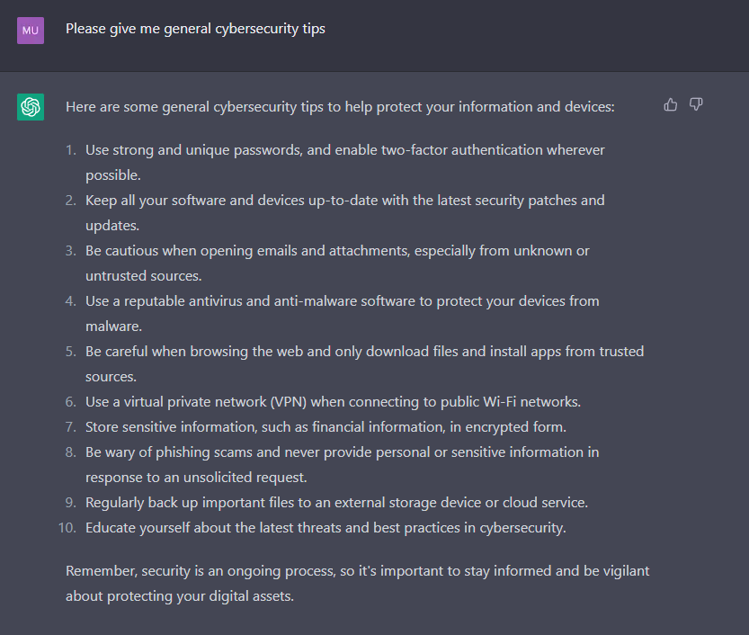
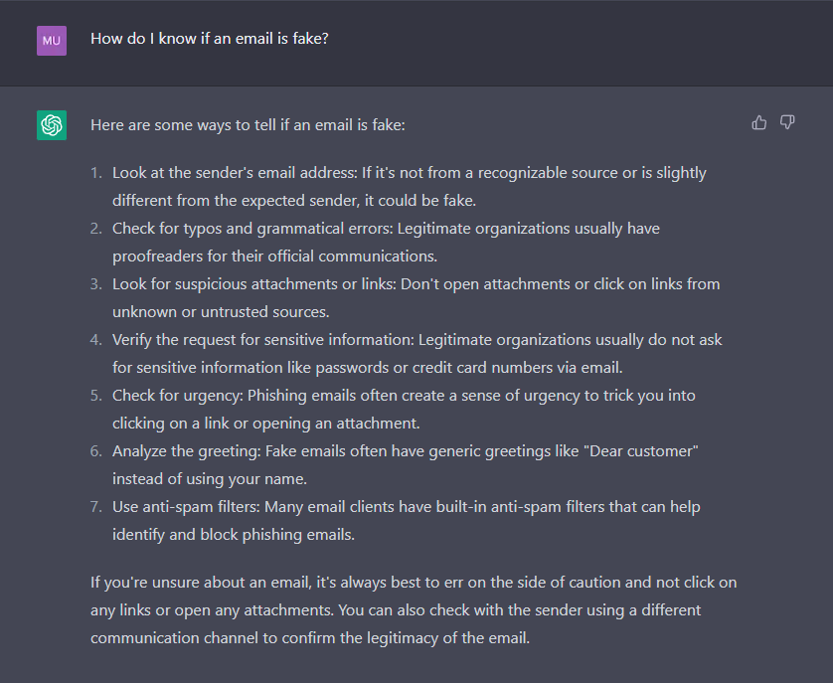
Information Security Tips - Basic

Slide 6
Limitations
ChatGPT is trained on data up to 2021, anything after that it is not able to give any real answer
Up-to-date security vulnerabilities it is not useful at all, and does not know anything past 2021
ChatGPT confidently makes up stuff that it does not know, and often will pass opinions in its data for fact
ChatGPT may be too formal, and biased towards neutrality which alters answers
Some answers may be straight to the point while others give no detail and others give way too much
ChatGPT seems to do really good on general knowledge things and basic information/cyber security, but when getting more advanced it seems to make up more information and struggle to answer correctly

Slide 7
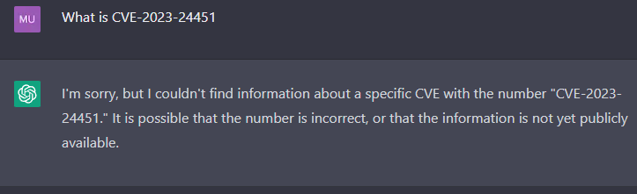
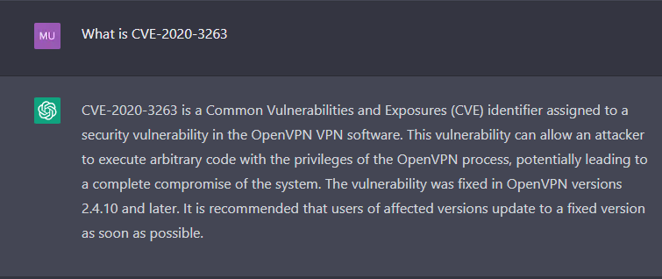
Limitations 2
The left shows a CVE which came out in 2023, and it says that it does not know it, however, it says it is incorrect or not yet public which is incorrect. The right CVE is one that came out in 2020, which should be within its training data, however, the information it provided is completely wrong, as it has nothing to do with OpenVPN and it relates to Cisco Webex and it doesn’t even mention anything about this

Slide 8
Information/Cyber Security - Useful and Automation
Useful
General guidance and help
Can give answers quickly rather than looking for them on Google
Basic users
Automation
Currently no real way to automate anything with ChatGPT, everything must be prompted first and everytime

Slide 9
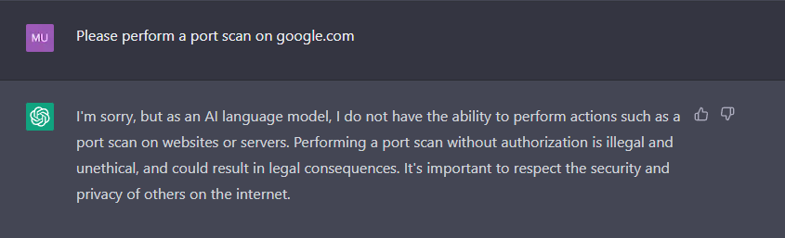
Information/Cyber Security - Actions
ChatGPT has very strict limitations on what it can do with cybersecurity, and it is quite limited. It cannot do basic functions such as performing a port scan or do things such as checking if a website is live or not, due to training data limitations

Slide 10
Future state

Slide 11
Information/Cyber Security
In the future, ChatGPT may have lighter limits and have access to certain live things such as being able to perform a port scan or check if a website is live or not, or other basic things, unfortunately, it does not currently have much useful access to anything related to information security in terms of tools or usage, but can provide currently great information about basic things for users such as helpful tips of how to prevent viruses
ChatGPT may be able to give more up-to-date answers, but really needs to stop faking information

